Slide 1
THIN SHELLS
By Dr. Andoh

Slide 2
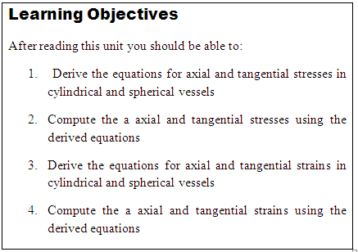

Slide 3
THIN CYLINDRICAL SHELLS
Introduction
In engineering field, we daily come across vessels of cylindrical and spherical shapes containing fluids such as tanks, boilers, compressed air receivers etc.
Generally, the walls of such vessels are very thin as compared to their diameter.
These vessels, when empty, are subjected to atmospheric pressure internally as well as externally. In such a case, the resultant pressure on the walls of the shell is zero.
But whenever a vessel is subjected to internal pressure (due to steam, compressed air etc.) its walls are subjected to tensile stresses.
In general if the thickness of the wall of a shell is less than 1/10th to 1/15th of its diameter, it is known as a thin shell.

Slide 4
Failure of a Thin Cylindrical Shell due to an Internal Pressure
We have already discussed in the last article that whenever a cylindrical shell is subjected to an internal pressure, its walls are subjected to tensile stresses.
It will be interesting to know that if these stresses exceed the permissible limit, the cylinder is likely to fail in anyone of the following two ways as shown in fig, 31.1 (a) and (b).

Slide 5
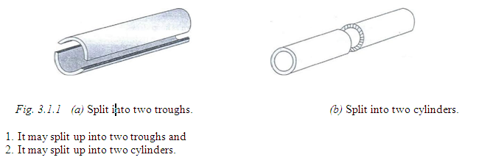

Slide 6
Stresses in a Thin Cylindrical Shell
We have already discussed that whenever a cylindrical shell is subjected to an internal pressure, its walls are subjected to tensile stresses. A little consideration will show that the walls of the cylindrical shell will be subjected to the following two types of tensile stresses:
i. Circumferential stress and
ii. Longitudinal stress
Circumferential Stress
In case of thin shells, the stresses are assumed to be uniformly distributed throughout the wall thickness. However in case of thick shells, the stresses are no longer uniformly distributed and the problem becomes complex. In this session, we shall discuss the stress in thin shells only.
NOTE: The above theory also holds good, when the shell is subjected to compressive stress

Slide 7
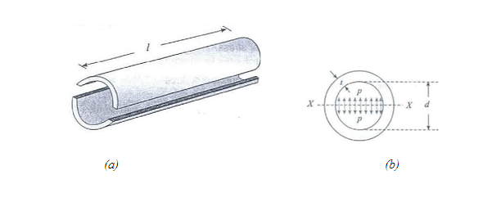

Slide 8
Consider a thin cylindrical shell subjected to an internal pressure as shown in Fig. 31.2(a) and (b). We know that as a result of the internal pressure, the cylinder has a tendency to split up into two troughs as shown in the figure.
Let l Length of the shell,
d Diameter of the shell,
t Thickness of the shell and
  p Intensity of internal pressure.

Slide 9
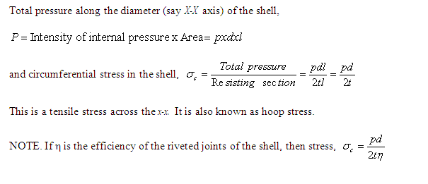

Slide 10
Longitudinal Stress
Consider the same cylindrical shell, subjected to the same internal pressure as shown Fig. 31.3 (a) and (b). We know that as a result of the internal pressure, the cylinder also has a to split into two pieces as shown in the figure.
Let p Intensity of internal pressure,
l Length of the shell,
d Diameter of the shell and
t Thickness of the shell.

Slide 11
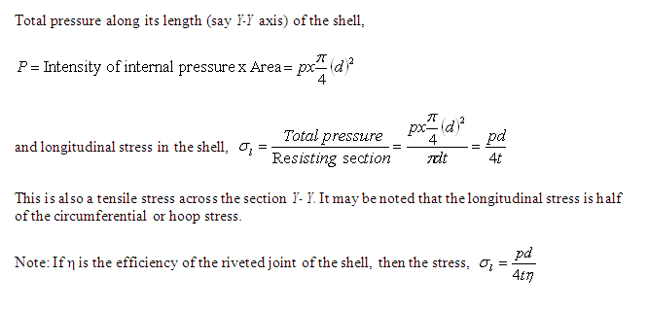

Slide 12
Example 6-1:
A stream boiler of 800 mm diameter is made up of 10 mm thick plates. If the boiler is subjected to an internal pressure of 2.5 MPa, find the circumferential and longitudinal stresses induced in the boiler plates.

Slide 13
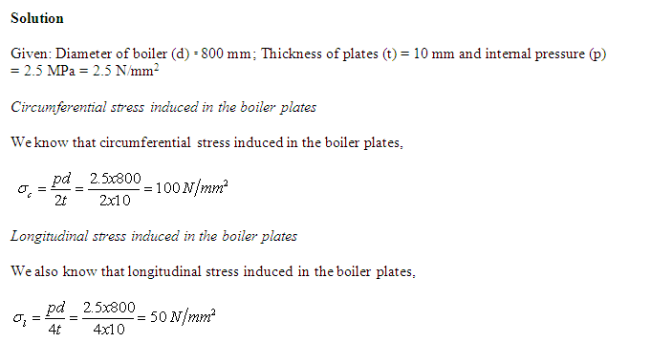

Slide 14
Example 6-2:
A cylindrical shell of 1.3 m diameter is made up of 18 mm thick plates. Find the circumferential and longitudinal stress in the plates. if the boiler is subjected to an internal pressure of 2.4 MPa. Take efficiency of the joints as 70%.

Slide 15
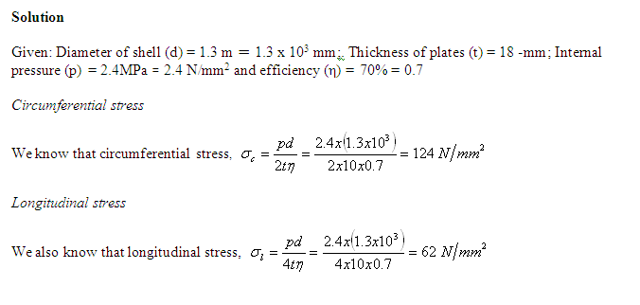

Slide 16
Example 6-.3:
A gas cylinder of internal diameter 40 mm is 5 mm thick, if the tensile stress in the material is not to exceed 30 MPa, find the maximum pressure which can be allowed in the cylinder.

Slide 17
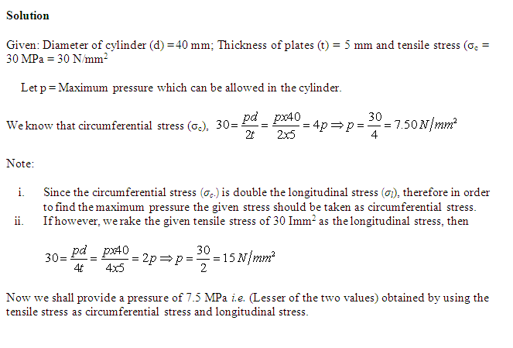

Slide 18
Design of Thin Cylindrical Shells
Designing of thin cylindrical shell involves calculating the thickness (t) of a cylindrical shell, the given length (l), diameter (d), intensity of maximum internal pressure (p) and circumference stress (σ_{c}), The required thickness of the shell is calculated from the relation.
If the thickness so obtained, is not a round figure, then next higher value is provided.
NOTE: The thickness obtained from the longitudinal stress will be half of the thickness obtained from circumferential stress. Thus, it should not be accepted.

Slide 19
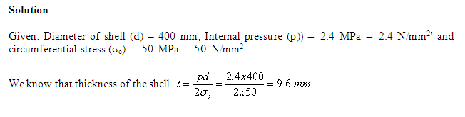
Example 6-4:
A thin cylindrical shell of4oo mm diameter is to be designed for an internal pressure of 2.4 MPa. Find the suitable thickness of the shell, if the allowable circumferential stress is 50 MPa.

Slide 20
Example 6-5:
A cylindrical shell of 500 mm diameter is required to withstand an. internal pressure of 4 MPa. Find the minimum thickness of the shell, if maximum tensile strength in the plate material is 400 MPa and efficiency of the joints is 65%. Take factor of safety as 5.

Slide 21
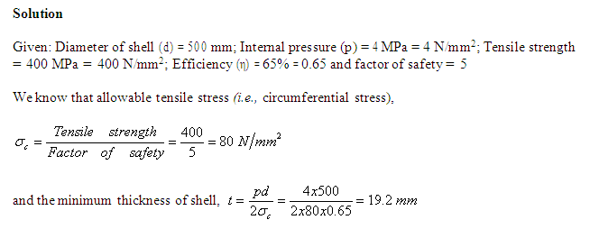

Slide 22
Change in Dimensions due to Internal Pressure
We have already discussed in the chapter on Elastic Constants that lateral strain is always accompanied by a linear strain. It is thus obvious that in a thin cylindrical shell subjected to an internal pressure, its wall will also be subjected to lateral strain. The effect of the lateral strains is to cause some change in the dimensions (i.e., length and diameter) of the shell. Now consider a thin cylindrical shell subjected to an internal pressure.
Let l Length of the shell,
d Diameter of (he shell.
  t Thickness of the shell and
p Intensity of the internal pressure

Slide 23
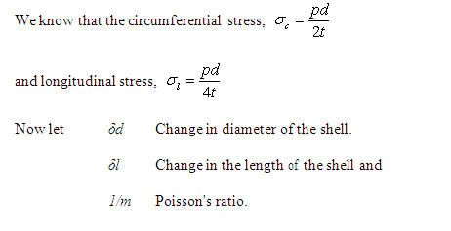

Slide 24
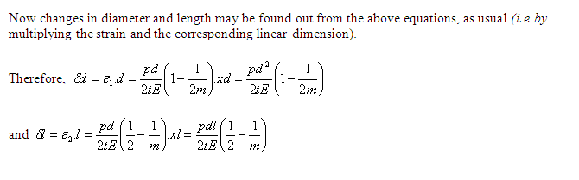

Slide 25
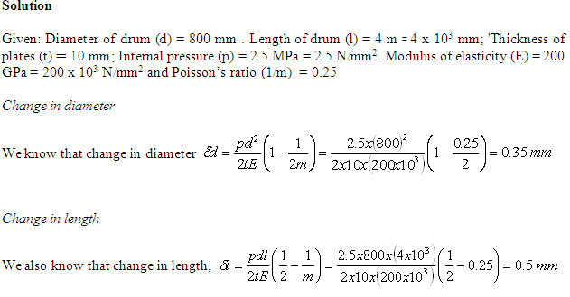
Example 6-6:
A cylindrical thin drum 800 mm in diameter and 4 m long is made of 1.0 mm thick plates. If the drum is subjected to an internal pressure of 2.5 MPa, determine its changes in diameter and length Take E as 200 GPa and Poisson's ratio as 0.25.

Slide 26
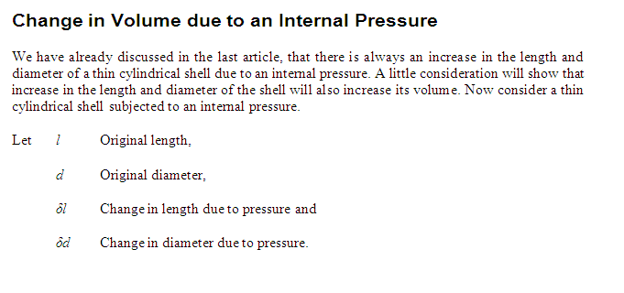

Slide 27
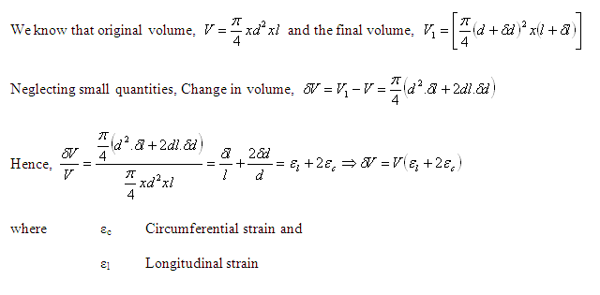

Slide 28
Example .6-7:
A cylindrical vessel 2 m. long and 500 mm in diameter with 10 mm thick plates is subjected to an internal pressure of 3 MPa. Calculate the change in volume of the vessel. Take E 200 GPa and. Poisson's ratio = 0.3 for the vessel material.

Slide 29
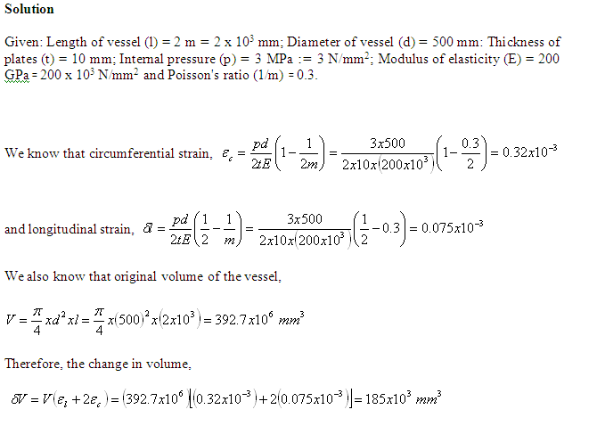

Slide 30
Application of Thin Cylindrical Shells
Riveted Cylindrical Shells
Sometimes, boilers of the desired capacity arc made of cylindrical shape by joining different plates usually by rivets. This is generally done:
by bending the plates to the required diameter and then joining them by a butt joint and
by joining individually fabricated shells by a lap joint as shown in Fig. 31.5 (a) and (b).

Slide 31
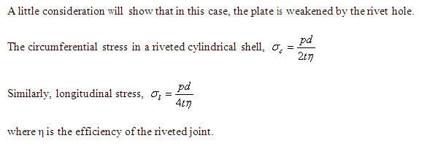

Slide 32
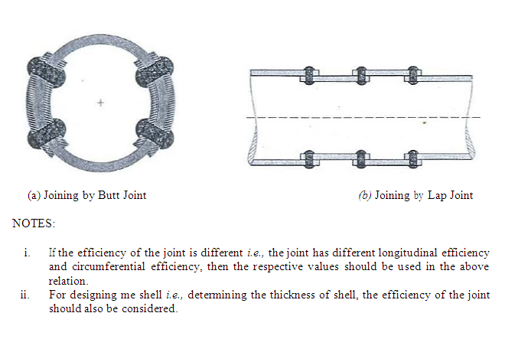

Slide 33
Example 6-8:
A boiler of shell of 2 m diameter is made up of mild steel plate of 20 mm thick: The efficiency of the longitudinal and circumferential joints is 70% and 60% respectively. Determine the safe pressure in the boiler; if the permissible tensile stress in the plate section through the rivets is 100 MPa. Also, determine the circumferential stress in the plate and longitudinal stress through the rivets.

Slide 34
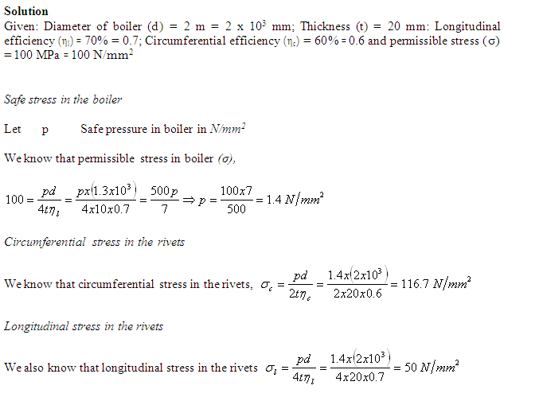

Slide 35
Wire-Bound Thin Cylindrical Shells
Sometimes, we have to strengthen a cylindrical shell against bursting in longitudinal section (i.e., due to hoop or circumferential stress).
This is done by winding a wire under tension, closely round the shell as shown in Fig. 31.6. Its effect will be to put the cylinder wall under initial compressive stress.

Slide 36
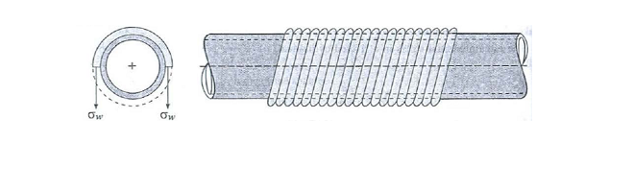
A little consideration will show that now if the internal pressure of the shell is increased, the bursting force will be resisted jointly by the shell section and the wires. It is thus obvious that a wire bound shell can withstand a greater internal pressure than an ordinary shell. In actual practice the winding wire is made of a high tensile material.
In such cases, the bursting force (due to internal pressure) per cm length is equal to the resisting force (due to pipe section + wire section). The circumferential strain in the pipe is also equal to the strain in the steel wire. The following example will illustrate the above mentioned statements.

Slide 37
Example 6-9:
A cast iron pipe of 300 mm internal diameter and 12 mm. thick is wound closely with a single layer of circular steel wire of 5 mm diameter under a tension of 60 MPa. Find the initial compressive stress in the pipe section. Also find the stresses set up in the pipe and steel wire when water under a pressure of 4 MPa is admitted into the pipe. Take E for cast iron and steel as 100 GPa and 200 GPa respectively. Poisson's ratio = 0.3.

Slide 38
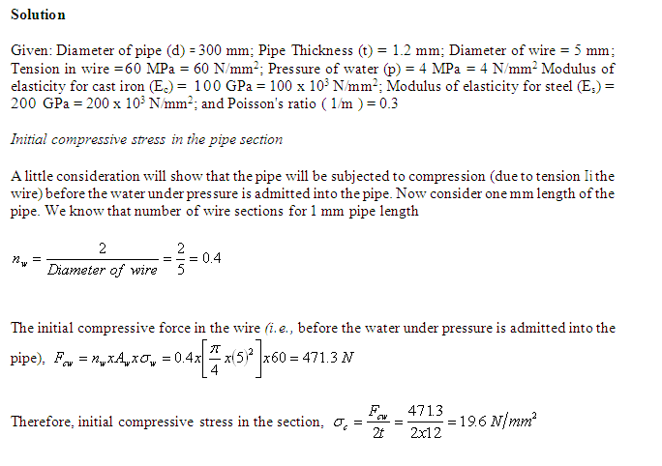

Slide 39
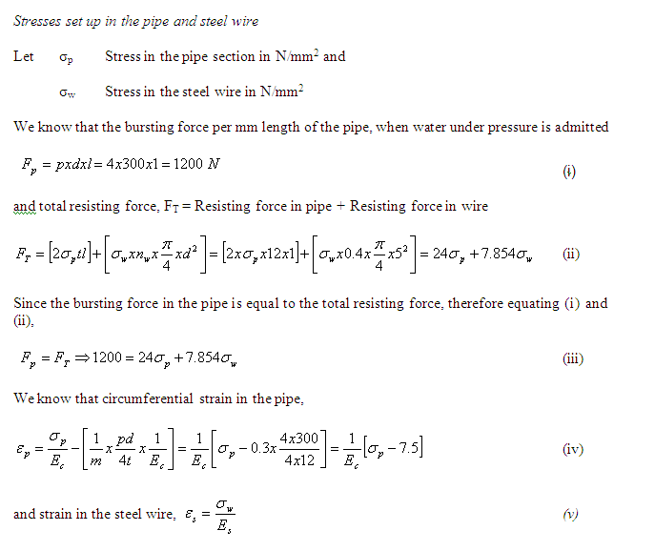

Slide 40
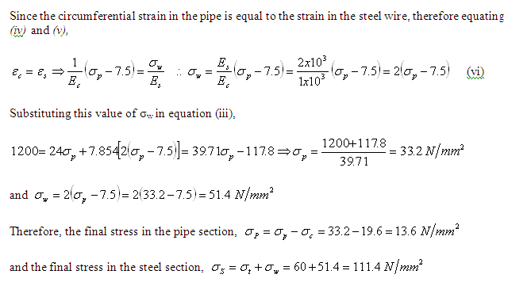

Slide 41
Self Assessment
Derive the equations for the
Longitudinal stress and hood stress
Longitudinal strain and hood strain

Slide 42
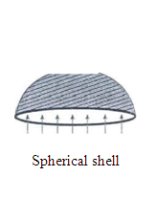
THIN SPHERICAL SHELLS
Stresses in Thin Spherical Shells
Consider a thin spherical shell subjected to an internal pressure a shown in the figure below

Slide 43
Let p Intensity of internal pressure,
d = Diameter of the shell and
T Thickness of the shell,
As a result of this internal pressure, the shell is likely to be torn away along the centre of the sphere.
Therefore total pressure acting along the centre of the sphere

Slide 44
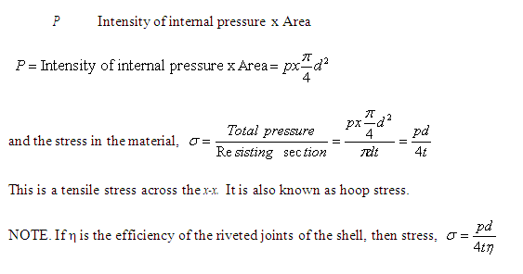

Slide 45
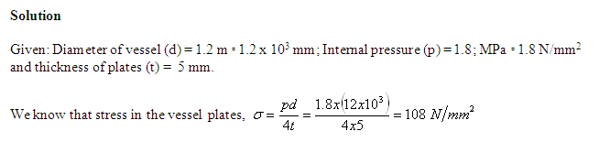
Example 6-10:
A spherical gas vessel of 1.2 m diameter is subjected to a pressure of 1.8 MPa. Determine the stress induced in the vessel plate, if its thickness is 5 mm.

Slide 46
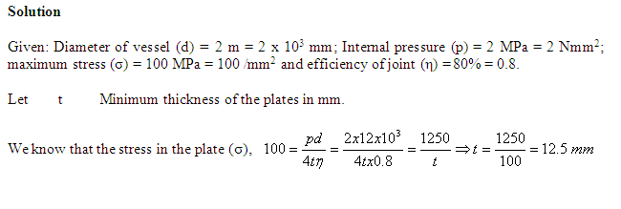
Example 11:
A spherical vessel of 2 m diameter is subjected to an internal pressure of 2 MPa. Find the minimum thickness of the plates required. if the maximum stress is not to exceed 100 MPa. Take efficiency of the joint as 80%.

Slide 47
Change in Diameter and Volume due to an Internal Pressure
Consider a thin spherical shell subjected to an internal pressure.
Let d = Diameter of the shell,
P Intensity of internal pressure and
t Thickness of the shell.

Slide 48
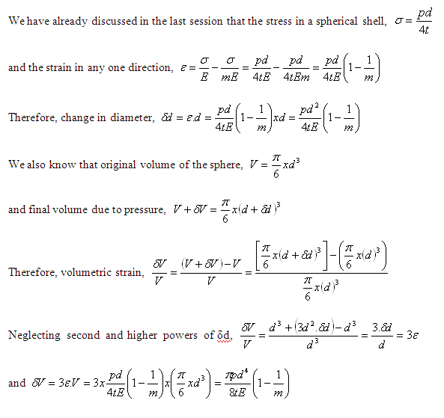

Slide 49
Example 12.
A spherical shell of 2 m diameter is made up of 10 mm thick plates. Calculate the change in diameter and volume of the shell, when it is subjected to an internal pressure of 1.6 MPa. Take E = 200 GPa and 1/m = 0.3.

Slide 50
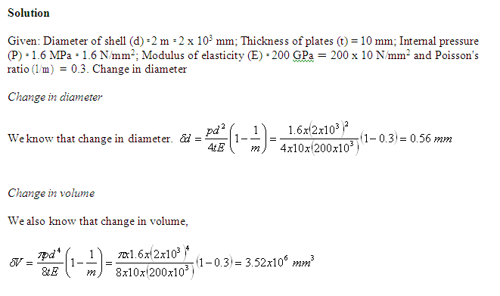

Slide 51

Bulk Modulus K
If a hydrostatic pressure p (is equal in all direction) acting on a body of initial volume V ,causes a reduction in volume equal to δV, then the bulk modulus K is defined as the ratio between the fluid pressure and volumetric strain.

Slide 52
Example 6-13:
A boiler drum consists of a cylindrical portion 2m long, 1m diameter, and 25mm thick is closed by a hemispherical ends. In a hydrostatic test to 10N/mm², how much additional water will be pumped in, after initial filling at atmospheric pressure?
Assume the circumferential strain at the junction of cylinder hemisphere is the same for both for the drum material. E==207,000 N/mm²; ν==0.3, for water K==2100 N/mm²

Slide 53
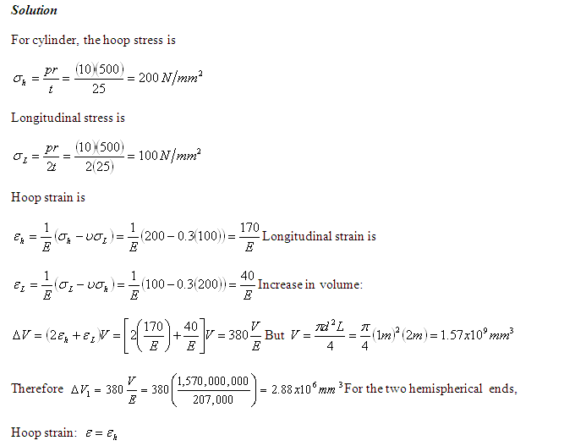

Slide 54
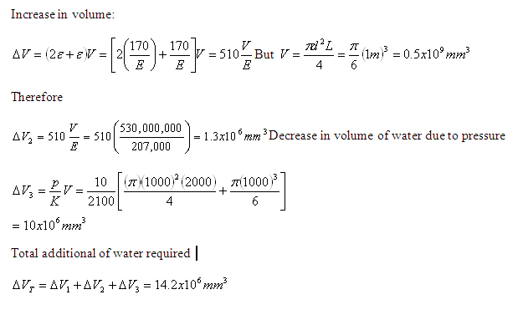

Slide 55
Self Assessment
1. Draw the Mohr’s circle for example 31

Slide 56
Unit Summary
The internal pressure acting on the long sides of the cylinder will give rise to a circumferential stress in the wall of the cylinder this is known as hoop stress.
If the ends of the vessel are closed the pressure acting on the ends is transmitted to the walls of the cylinder thin producing a longitudinal or stress.
That is cylinders with the ratio of thickness to internal diameter less than 1:20.
A spherical pressure vessel is really just a special case of a cylindrical vessel.
No matter how the sphere is cut in half, the pressure load perpendicular to the cut must equal the shell stress load

Slide 57
Review Question:
State and derive the relation stress and strain in cylindrical pressure vessel.
Discussion Question:
Consider a cylindrical pressure vessel with a wall thickness of 25 mm, an internal pressure of 1.4 MPa, and an outer diameter of 1.2 m. Find the axial and tangential stresses and strains. Draw the Mohr’s circle assuming a plane stress conditions. Hence find the principal stresses and strains and the maximum shearing stress and strain. Take E==200,000Nmm⁻² and ϑ==0.3

Slide 58
Assignments 6
Quizzes
Distinguish between circumferential stress and longitudinal stress in a cylindrical shell, when subjected to an internal pressure.
Show that in the case of a thin cylindrical shell subjected to an internal fluid pressure, the tendency to burst lengthwise is twice as great as in a transverse section.
Derive a relation for the changes of diameter and length of a thin cylindrical shell, when subjected to an internal pressure.
Distinguish between cylindrical shell and spherical shell.
Derive a formula for the hoop stress in a thin spherical shell subjected to an internal pressure,

Slide 59
Homework
A thin wall cylindered has an internal diameter of 20 cm and is 0.5 cm thick. It is subjected to an internal pressure of 3.5 MN/m². Estimate the hoop and longitudinal stress of the ends if the cylinder ends are closed
A boiler drum consists of a cylindrical portion 4m long, 1m diameter, and 25mm thick is closed by a hemispherical ends. In a hydrostatic test to 10N/mm², how much additional water will be pumped in, after initial filling at atmospheric pressure? Assume the circumferential strain at the junction of cylinder hemisphere is the same for both for the drum material. E==207,000 N/mm²; ν==0.3, for water K==2100 N/mm²
Consider two laminated pressure vessel with an initial interference on diameter of 0.25 mm. The thickness of the inner shell is 2.5mm, and that of the outer shell is 2.0mm. The outer cylinder is heated, placed on the inner and allowed to cool, thus providing a ‘shrink fit’. If both cylinders after cooling assume a common diameter of 100 mm find the interface pressure if both shell are made of steel E==207,000N/mm²

Slide 60
4. Consider a thin steel cylinder junction fitting over copper inner cylinder as shown. Find the hoop stresses in each shell due to a temperature rise of 30K. Assume there is no longitudinal stress
5. Consider a thin steel cylinder junction fitting over copper inner cylinder as shown. Find the hoop stresses in each shell due to a temperature rise of 30 K. Assume there is no longitudinal stress

